Slide 1
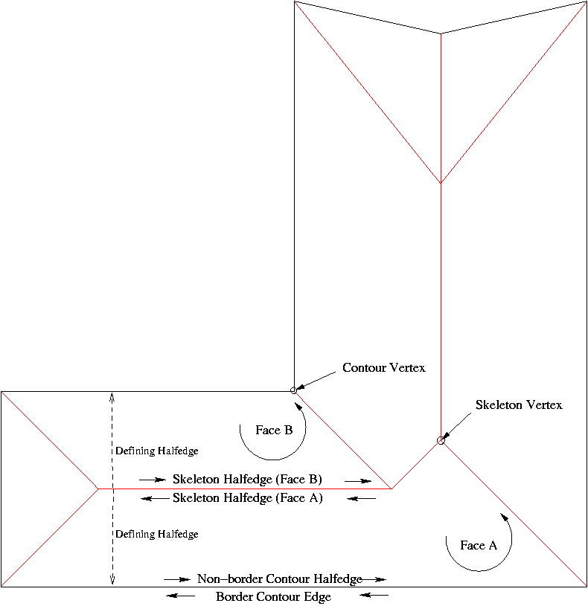
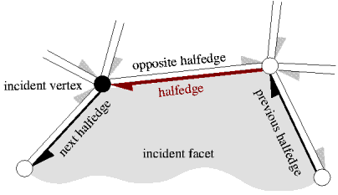
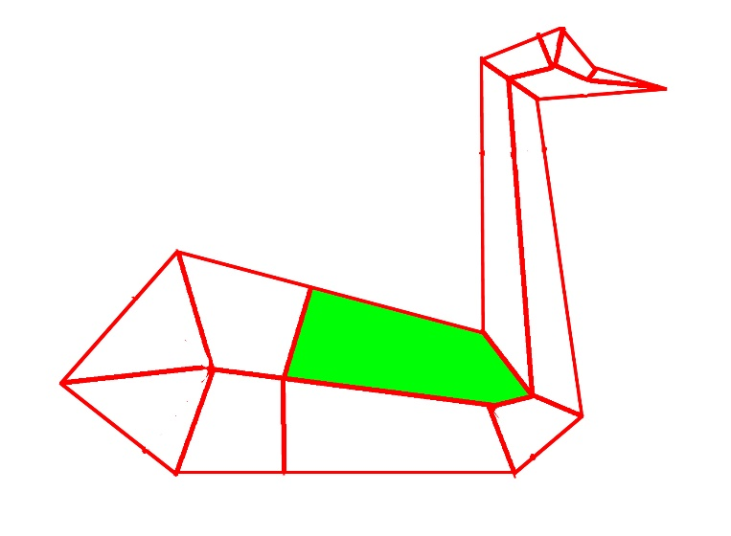
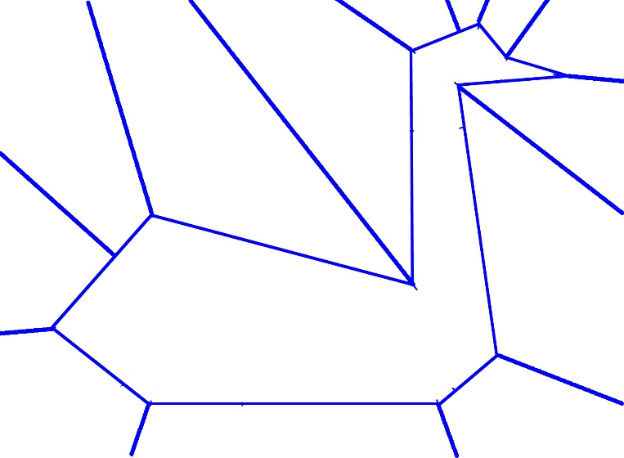
Data structure
“skeleton face” – different from the paper
ISS(interior straight skeleton)
Face id : original + # of iss faces
ESS(enterior straight skeleton)

Slide 2
Access flow
Primitives
Functions / Members
Skeleton
Vertex
HalfEdge_aroud_vertex
+(Halfedge->face)
Skeleton
Face
Corresponding
Cut edges
( Halfedge->next ) + ( !is_bisector() )
Skeleton
Edges
Skeleton
Face
Reflection
( Halfedge->next ) + test ray hit
stitchedGraph-> fid_ess/fid_iss
+ compare face id
+ compute perpendicular ray

Slide 3
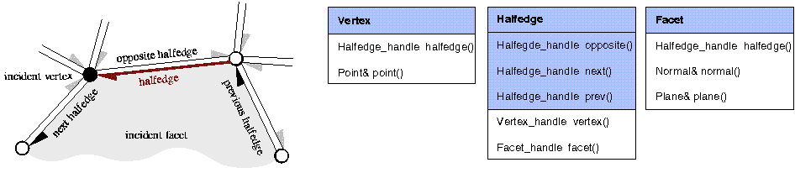
Data Structure
( Halfedge->next ) + ( !is_bisector() )
HalfEdge_aroud_vertex
+(Halfedge->face)
Stitched Graph
Cut edge Fid_iss Fid_ess
stitchedGraph-> fid_ess/fid_iss
+ compare face id
+ compute perpendicular ray
( Halfedge->next ) + test ray hit

